Slide 1
CS2030 Exam Revision Part 1
By Jeremy Lim

Slide 2
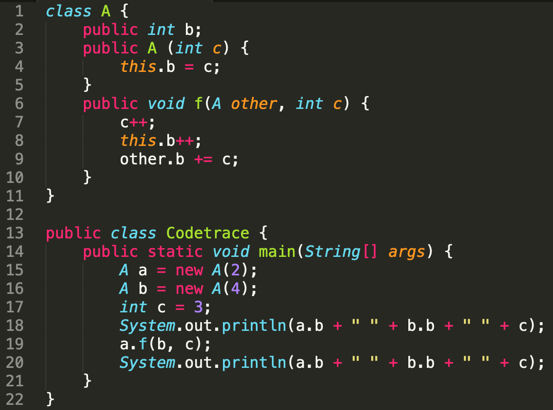
Java Memory Model (Stack and Heap)
Given the following code:
What is the output?
Codetrace.java

Slide 3
Java Memory Model (Stack and Heap)
Given the following code:
What is the output?
2 4 3 3 8 3

Slide 4
Java Memory Model (Stack and Heap)
Given the following code:
Draw the stack and heap after
Line 17
Line 9
Line 20

Slide 5
Draw the stack and heap after line 17
Heap
Stack
int b = 2
A a
Pointer to an object on the heap

Slide 6
Draw the stack and heap after line 17
Heap
Stack
int b = 2
A a
A b
int b = 4

Slide 7
Draw the stack and heap after line 17
Heap
Stack
int b = 2
A a
A b
int b = 4
int c = 3
Primitives are only on the stack

Slide 8
Draw the stack and heap after line 9
Heap
Stack
int b = 2
A a
A b
int b = 4
int c = 3

Slide 9
Draw the stack and heap after line 9
Heap
Stack
int b = 2
A a
A b
int b = 4
int c = 3
f
New scope when entering method

Slide 10
Draw the stack and heap after line 9
Heap
Stack
int b = 2
A a
A b
int b = 4
int c = 3
f
Copy of pointer (Points to same object)
A other
Copy of primitive
int c = 3
this
Remember ‘this’

Slide 11
Draw the stack and heap after line 9
Heap
Stack
int b = 2
A a
A b
int b = 4
int c = 3
f
A other
Original c untouched
int c = 4
this

Slide 12
Draw the stack and heap after line 9
Heap
Stack
int b = 3
A a
A b
int b = 4
int c = 3
f
A other
int c = 4
this

Slide 13
Draw the stack and heap after line 9
Heap
Stack
int b = 3
A a
A b
int b = 8
int c = 3
f
A other
int c = 4
this

Slide 14
Draw the stack and heap after line 20
Heap
Stack
int b = 3
A a
A b
int b = 8
int c = 3

Slide 15
Practice Question 1
Refer to Codetrace2.java
Draw the stack and heap after
Line 7 (the first time)
Line 28
Line 16
Line 31
What is the output of the program?

Slide 16
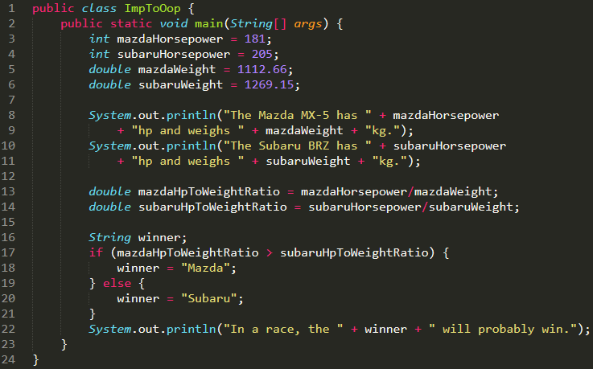
Imperative to OOP
Convert the following imperative code to OOP style
ImpToOop.java

Slide 17
Imperative to OOP
Convert the following imperative code to OOP style
Step 1: Identify common items

Slide 18
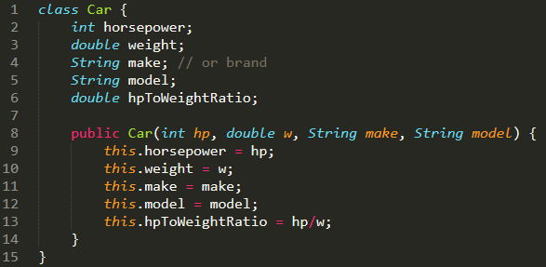
Imperative to OOP
Convert the following imperative code to OOP style
Step 1: Identify common items
Step 2: Create class

Slide 19

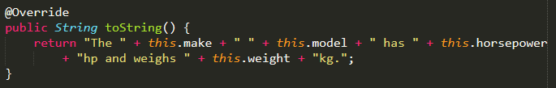
Imperative to OOP
Convert the following imperative code to OOP style
Step 1: Identify common items
Step 3: Add methods

Slide 20
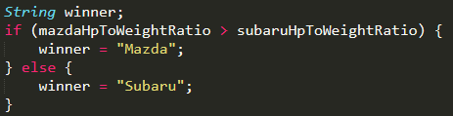
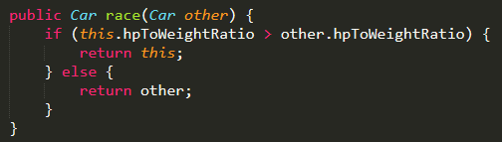
Imperative to OOP
Convert the following imperative code to OOP style
Step 1: Identify common items
Step 3: Add methods

Slide 21
Imperative to OOP
Convert the following imperative code to OOP style
Step 1: Identify common items
Step 3: Add methods

Slide 22
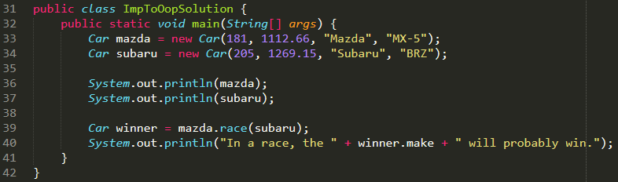
Imperative to OOP
Convert the following imperative code to OOP style
Step 1: Identify common items
Step 3: Add methods
Step 4: Make main
ImpToOopSolution.java

Slide 23
Access Modifier
Note: “Same Class” != “Same File”
Access Modifier \ Accessing Class | All Classes | Same Package | Child classes | Same Class
Public | ✔️ | ✔️ | ✔️ | ✔️
Default (Package Protected) | ❌ | ✔️ | ✔️ | ✔️
Protected | ❌ | ❌ | ✔️ | ✔️
Private | ❌ | ❌ | ❌ | ✔️

Slide 24
How Polymorphism Works (Reference)
See Tutorial 1 slides

Slide 25
Abstract classes
When to use:
When it makes no sense to have an instance of the class
E.g. new Shape() instead of new Rectangle()
How to use:
Declare abstract methods as abstract without implementation
E.g. protected abstract void f();
Public ✔️, Protected ✔️, Package Protected ✔️, Private ❌
Child classes must override all abstract methods
No such thing as common constructor
To use a common constructor, call super(…) in the child constructor
AbstractClass.java

Slide 26
Interfaces
All methods are abstract by default
Use default keyword to give an implementation
E.g. default int f() { return 1; }
All interface variables are static
A class can implement more than one interface
But default methods are not to give classes plug-in functionality!
Interfaces, abstract classes are types
E.g. List<Integer> list = new ArrayList<Integer>();
^ List is an interface
The type of the variable only affects what methods/object variables can be called

Slide 27
Practice Question 2
Rewrite BasicMath.java using OOP
Hint: Abstract class
Intended Solution: (Remove highlight below to see)
Abstract class Operation, classes Addition, Substraction,… extend Operation
Constructor of subclasses take a parameter int c which is stored in the object (All operations do +c so it is common)
Abstract method run(int a, int b) to do the calculation

Slide 28
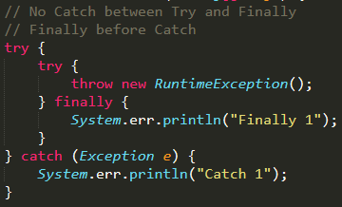
Exceptions
MOST IMPORTANT: finally before catch if catch is not before finally
Exceptions.java

Slide 29
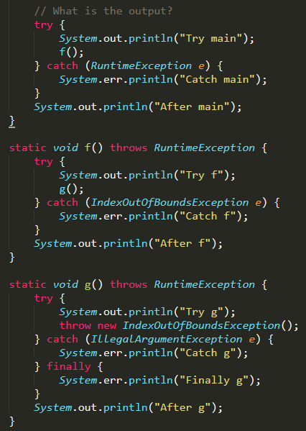
Exceptions
What is the output?

Slide 30
Exceptions
What is the output?
Try main
Try f
Try g
Finally g
Catch f
After f
After main

Slide 31
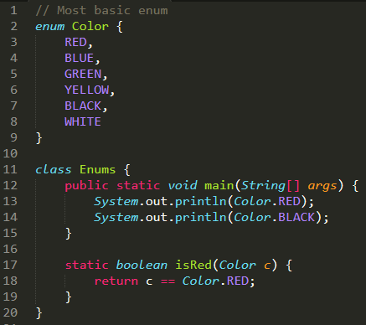
Enum
Type of class where every constant is a public static final instance of itself
That’s why the equality check works (comparing pointers)
Enums.java

Slide 32
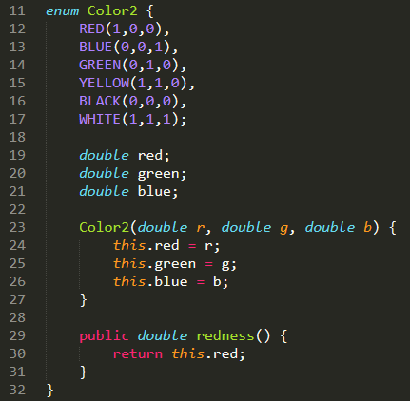
Enum
Can have private constructors (default is private)
Can have variables and methods (access modifiers are as per normal)

